Slide 1
Black Box and White Box Testing

Slide 2
Version Control and Revision History
 | Name | Date
Prepared By | Sneha Kumar | 07-Mar-2019
Reviewed By | Manisha Mane | 07-Mar-2019
Approved By | Nisha Mendonsa | 07-Mar-2019
Version No. | Date | Section Affected | Highlight of Changes
1.0.0 | 07-Mar-2019 | All | Original Version.

Slide 3








Iconic Representations.......
Test your Memory
Can you Solve?
Objective
Coffee Break
Queries
Recap
Need more Info
Brainstorm

Slide 4

Objectives
The objective of this session is to make participants understand the Balck Box and white box testing techniques

Slide 5
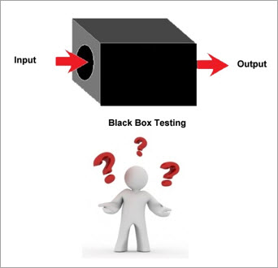
Test Methods
Black Box Testing:
Black box testing is testing that ignores the internal mechanism of a system or component and focuses solely on the outputs generated in response to selected inputs and execution conditions.
also called as Behavioral testing, Functional testing, Data driven testing, I/O driven testing)
The system is considered as a black box where the outputs of the test results are matched against user Specifications
Inputs are given and outputs are compared against specifications.
No implementation details of the code are considered.
Test cases are based on requirement specifications.

Slide 6
White Box Testing:
White box testing is testing that takes into account the internal mechanism of a system or component.
Also called as Structural testing, Glass box testing, Transparent-box and Clear box Testing.
Contrary to black box testing.
Testing based on analysis of internal logic (design, code, etc.).
White-box testing techniques apply primarily to lower levels of testing (e.g., unit and component).
Targets to check control flow, looping, dataflow, all the nodes and paths.
Mandatory to have a knowledge of code in which the system is designed.

Slide 7
Black Box Testing | White Box Testing
the main focus of black box testing is on the validation of your functional requirements. | White Box Testing (Unit Testing) validates internal structure and working of your software code
Black box testing gives abstraction from code and focuses testing effort on the software system behaviour. | To conduct White Box Testing, knowledge of underlying programming language is essential. Current day software systems use a variety of programming languages and technologies and its not possible to know all of them.
Black box testing facilitates testing communication amongst modules | White box testing does not facilitate testing communication amongst modules

Slide 8
Black Box Testing
Test Case Design methods:
Equivalence Class partitioning method
Boundary value analysis
Decision Tables
State transition testing
Use case based testing
Error guessing

Slide 9
Equivalence Class partitioning method
This technique is also known as Equivalence Class Partitioning (ECP).
In this technique, input values to the system or application are divided into different classes or groups based on its similarity in the outcome.
Hence, instead of using each and every input value we can now use any one value from the group/class to test the outcome.
In this way, we can maintain the test coverage while we can reduce a lot of rework and most importantly the time spent.

Slide 10
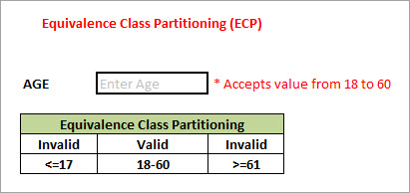
As present in the above image, an “AGE” text field accepts only the numbers from 18 to 60. There will be three set of classes or groups.
Two invalid classes will be:
a) Less than or equal to 17.
b) Greater than or equal to 61.
One valid class will be anything between 18 to 60.
We have thus reduced the test cases to only 3 test cases based on the formed classes thereby covering all the possibilities. So, testing with any one value from each set of the class is sufficient to test the above scenario.

Slide 11
Boundary Value Analysis:
Boundary Value Analysis (BVA) is a test Functional Testing technique where the extreme boundary values are chosen
Boundary means the values near the limit where the behavior of the system changes. In boundary value analysis both the valid inputs and invalid inputs are being tested to verify the issues.
.Boundary values include maximum, minimum, just inside/outside boundaries, typical values, and error values.
Extends equivalence partitioning, Test both sides of each boundary. Look at output boundaries for test cases too. ➢ Min – 1, Min, Min +1, Nom, Max -1, Max, Max +1
Example:
If we want to test a field where values from 1 to 100 should be accepted then we choose the boundary values: 1-1, 1, 1+1, 100-1, 100, and 100+1. Instead of using all the values from 1 to 100, we just use 0, 1, 2, 99, 100, and 101.

Slide 12
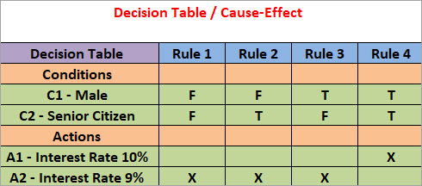
Decision Table
Explore combinations of inputs, situations or events.
It is very easy to overlook specific combinations of input .
Start by expressing the input conditions of interest so that they are either TRUE or FALSE.
Example
Take an example of XYZ bank that provides interest rate for the Male senior citizen as 10% and for rest of the people 9%.

Slide 13
In this example condition, C1 has two values as true and false, condition C2 also has two values as true and false. The number of total possible combinations would then be four. This way we can derive test cases using decision table.

Slide 14
State Transition Testing:
State Transition Testing is a technique that is used to test the different states of the system under test.
The state of the system changes depending upon the conditions or events.
The events trigger states which become scenarios and a tester needs to test them.
A systematic state transition diagram gives a clear view of the state changes but it is effective for simpler applications.
More complex projects may lead to more complex transition diagrams thus making it less effective.
Example
In a Banking application login screen the correct login and password need to be entered to access the account details. 3 attempts are allowed and if a wrong password is entered the 4th time, the account is locked. So, testing with the correct password and with an incorrect password is compulsory, for that we use state transition testing.

Slide 15
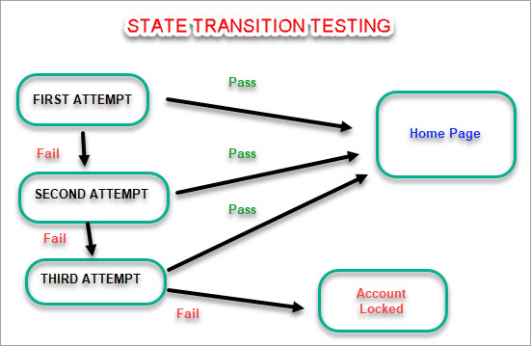

Slide 16
Use case based testing
Use Cases capture the interactions between 'actors' and the 'system'.
'Actors' represents user and their interactions that each user takes part into.
Test cases based on use cases and are referred as scenarios.
Capability to identify gaps in the system which would not be found by testing individual components in isolation.
Very effective in defining the scope of acceptance tests.

Slide 17
Error Guessing
This is a classic example of experience based testing.
In this technique, the tester can use his/her experience about the application behavior and functionalities to guess the error-prone areas. Many defects can be found using error guessing where most of the developers usually make mistakes.
Few common mistakes that developers usually forget to handle: Divide by zero.
Handling null values in text fields.
Accepting Submit button without any value.
File upload without attachment.
File upload with less than or more than the limit size.

Slide 18
Advantages of Black box testing
More effective on larger units of code than glass box testing.
Testers and developers are independent of each other.
Tester needs no knowledge of code in which system is designed.
Testing is done from a user’s point of view.
Test cases can be designed as soon as specifications are complete.

Slide 19
Disadvantages of Black Box testing
Only a small number of possible inputs can actually be tested
Without clear and concise specifications, test cases are hard to design.
Repetition of test inputs if tester is not informed of the test cases the programmer has already tried.
May leave many program paths untested.

Slide 20
Tools used for Black Box Testing:
Tools used for Black box testing largely depends on the type of black box testing you are doing.
For Functional/ Regression Tests you can use – QTP,Seleniumnium
For Non-Functional Tests, you can use – Loadrunner,Jmeter

Slide 21
White Box Testing Techniques
Statement Coverage
Branch Coverage
Path Coverage

Slide 22
Statement coverage
Execute all the statements at least once
Weakest form of coverage as it requires every line of code to be checked

Slide 23
Decision coverage(Branch coverage)
Exercise all logical decision on their true or false sides.
To test the branch we must once
check the true condition and once
the false condition

Slide 24
Condition Coverage
Execute each decision with all possible outcomes at least once It requires all cases.
Checks each of the ways condition can be made true or false

Slide 25
Advantage of WBT
As the knowledge of internal coding structure is pre-requisite, it becomes very easy to find out which type of input/data can help in testing the application effectively.
It helps in optimizing the code.
Helps in removing the extra lines of code, which can bring in hidden defects.

Slide 26
Disadvantages of WBT
As the knowledge of internal coding structure is pre-requisite, a skilled tester is needed. So cost increases.
It is impossible to look into every bit of code to find out hidden errors, which may create problems, resulting in failure of an application.
It fails to detect missing functions.

Slide 27
Gray Box Testing
Gray Box Testing is a combination of Black Box Testing method and White Box Testing method.
The internal structure is partially known
This involves having access to internal data structures and algorithms for purposes of designing the test cases, but testing at the user, or black-box level
Gray Box Testing is named so because the software program, in the eyes of the tester is like a gray/ semi-transparent box; inside which one can partially see.

Slide 28
Questions

Slide 29
Thank You.

